Slide 1
TRANSACTIONS
Lecture 22

Slide 2
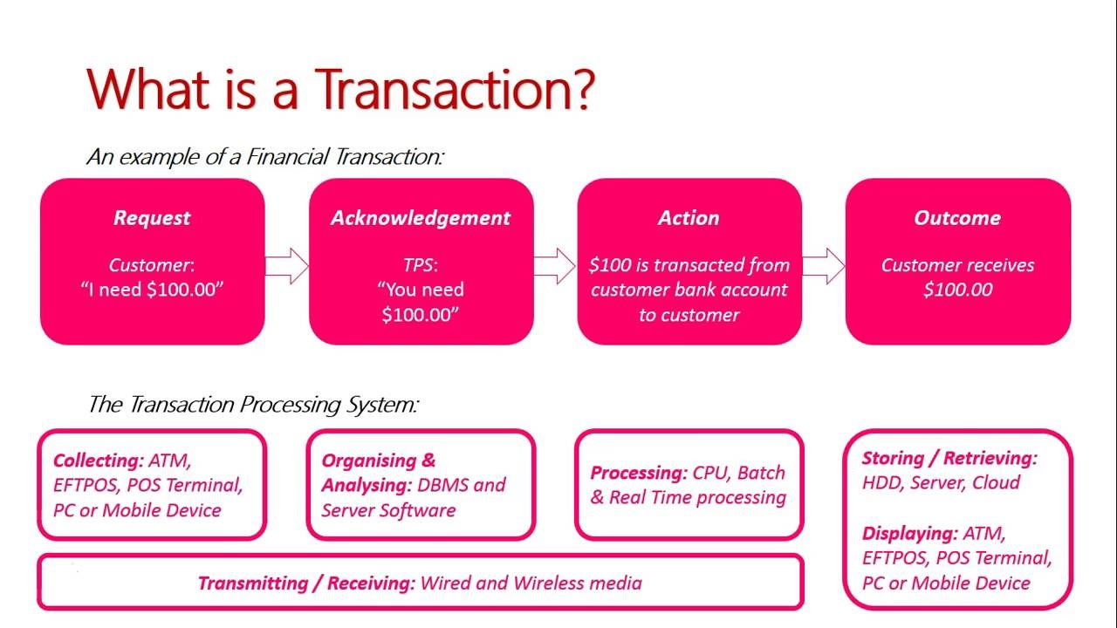

Slide 3
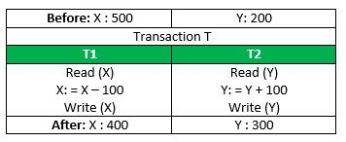
TRANSACTION CONCEPT
A transaction is a unit of program execution that accesses and possibly updates various data items.
E.g. transaction to transfer $100 from account X to account Y:
  1. read(X)
  2. X := X – 100
  3. write(X)
  4. read(Y)
  5. Y := Y + 100
  6. write(Y)

Slide 4
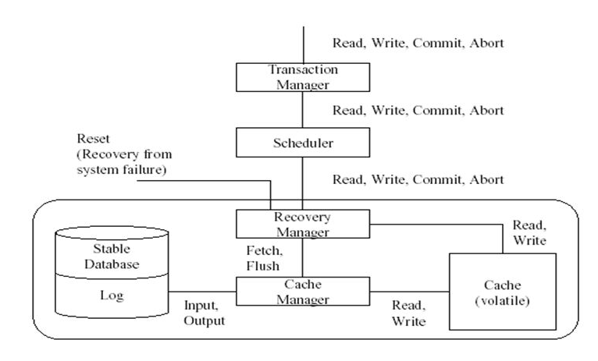
DBMS TRANSACTION SUBSYSTEM

Slide 5
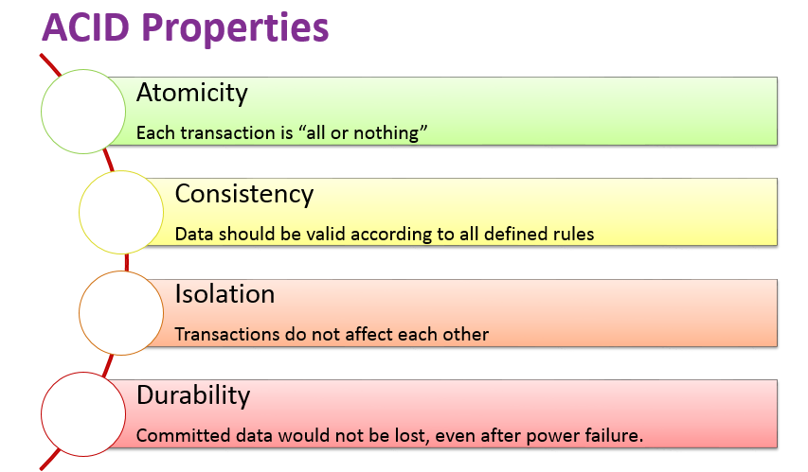

Slide 6
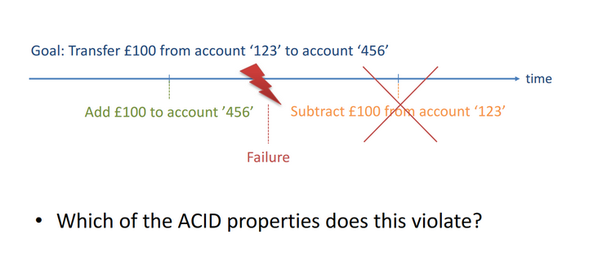

Slide 7
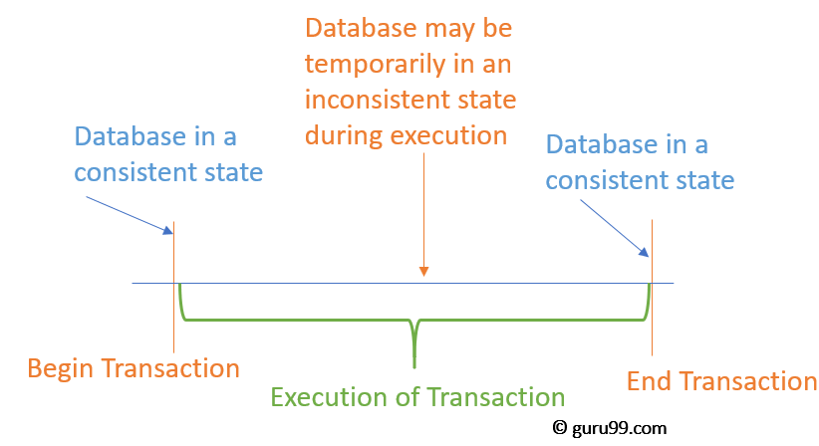

Slide 8
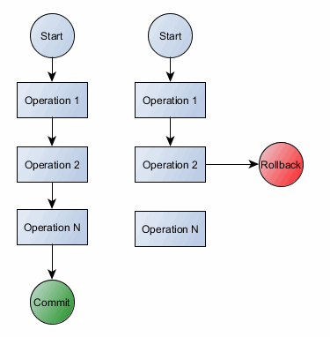

Slide 9
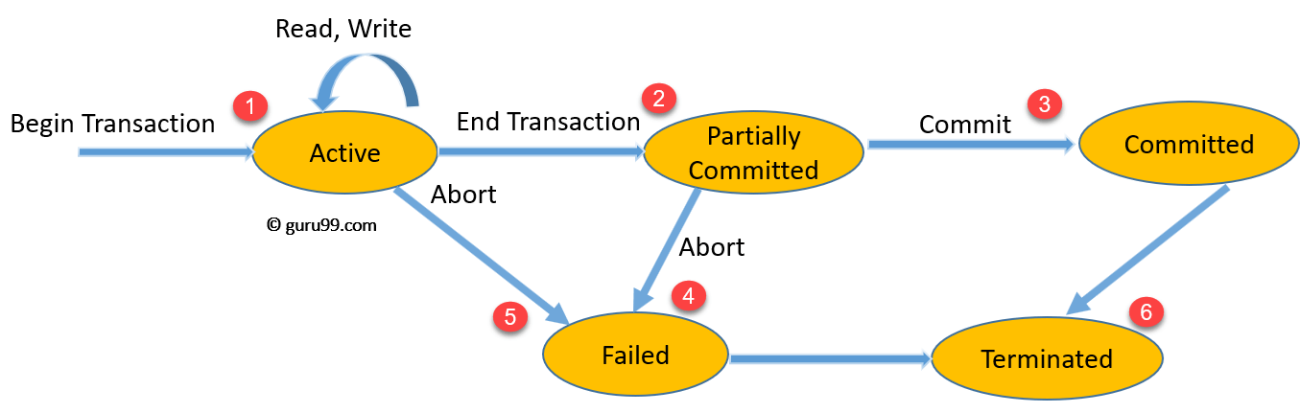
TRANSACTION STATE

Slide 10
SCHEDULES
Transactions hold many queries, schedules hold many transactions.
The basic syntax of a schedule is:
S — The schedule itself.
R — Read an item.
W — write an item
C — commit an item
A — abort the item

Slide 11
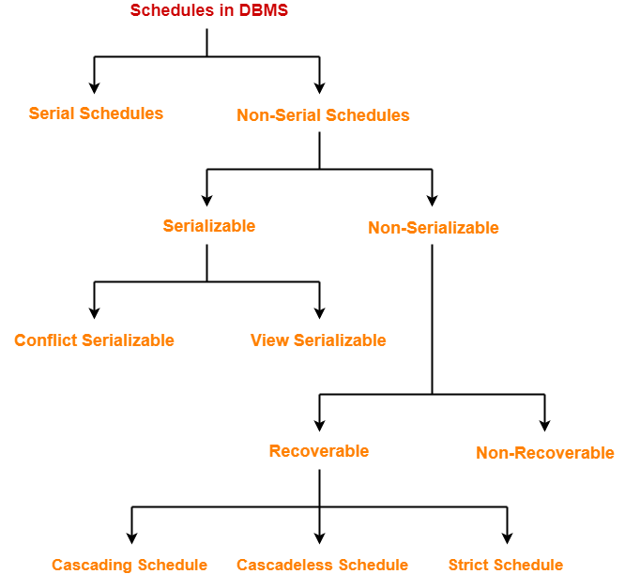

Slide 12
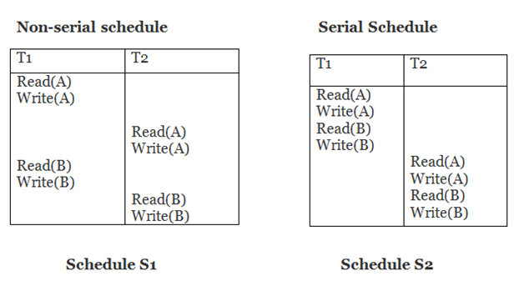
SERIAL SCHEDULES-
All the transactions execute serially one after the other.
When one transaction executes, no other transaction is allowed to execute.

Slide 13
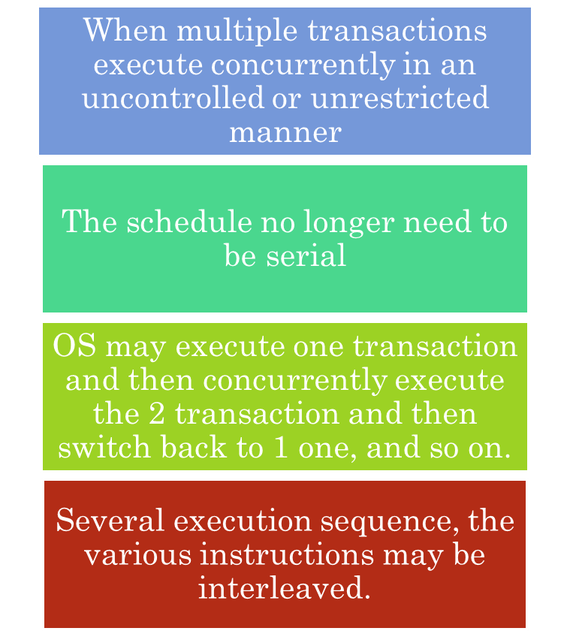
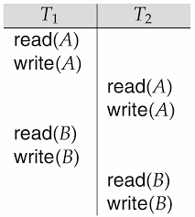
CONCURRENT SCHEDULES

Slide 14
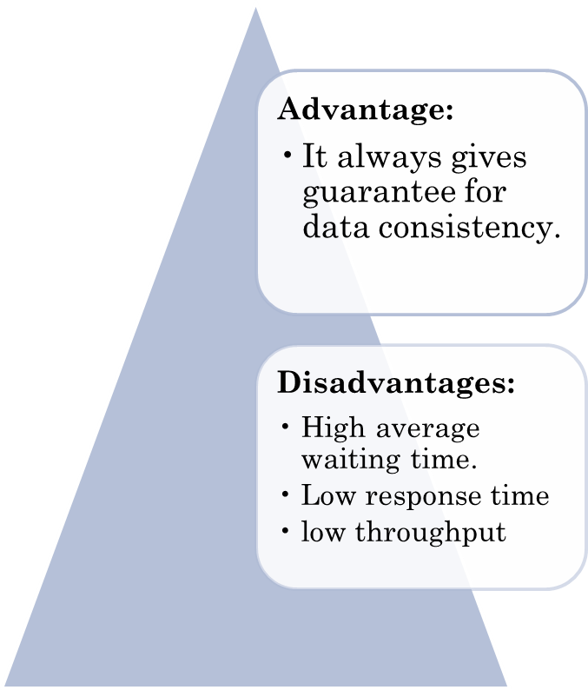
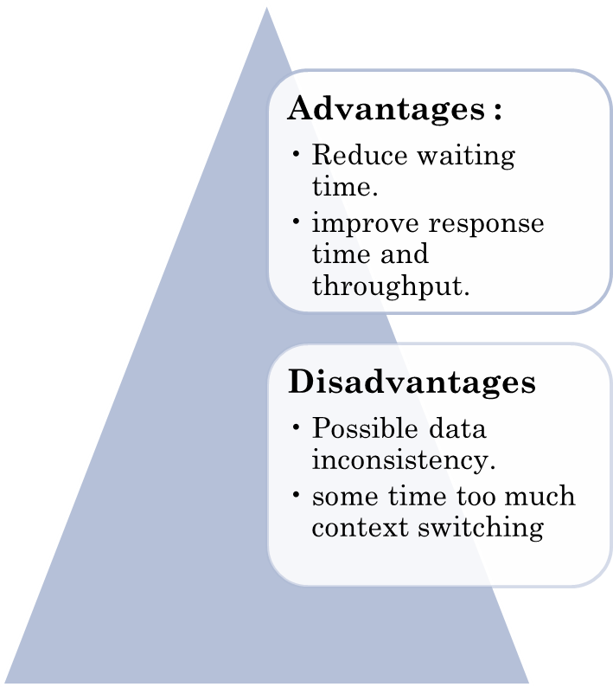
Serial Schedule
Concurrent Schedule

Slide 15
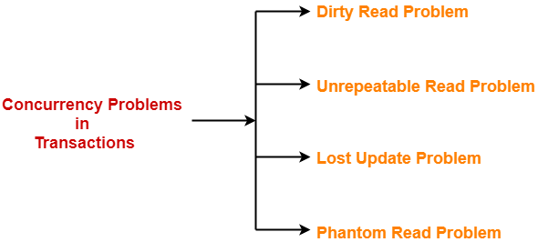
CONCURRENCY PROBLEMS.
When multiple transactions execute concurrently in an uncontrolled or unrestricted manner, then it might lead to several problems.
Such problems are called as concurrency problems.

Slide 16
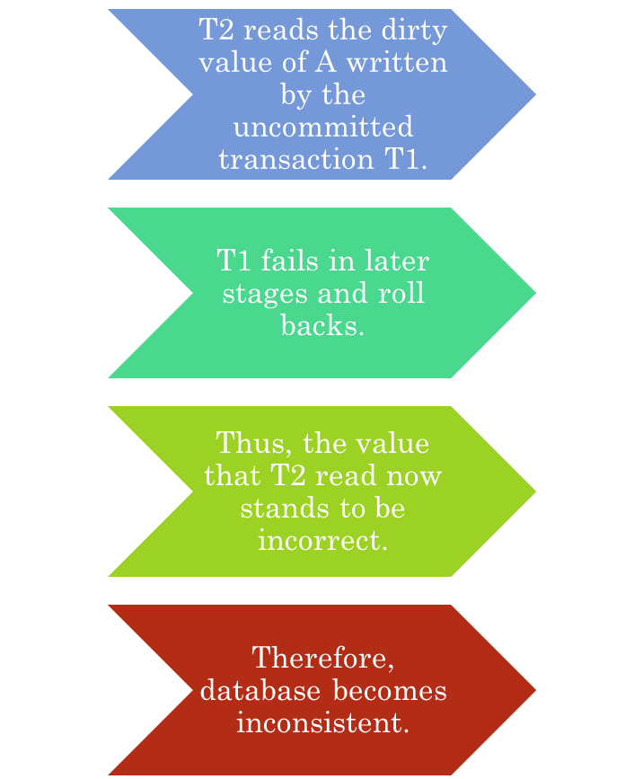
1. DIRTY READ PROBLEM
Transaction T1 | Transaction T2
R(A)
W(A)
 | R(A) //Dirty Read
 | W(A)
 | Commit
Failure

Slide 17
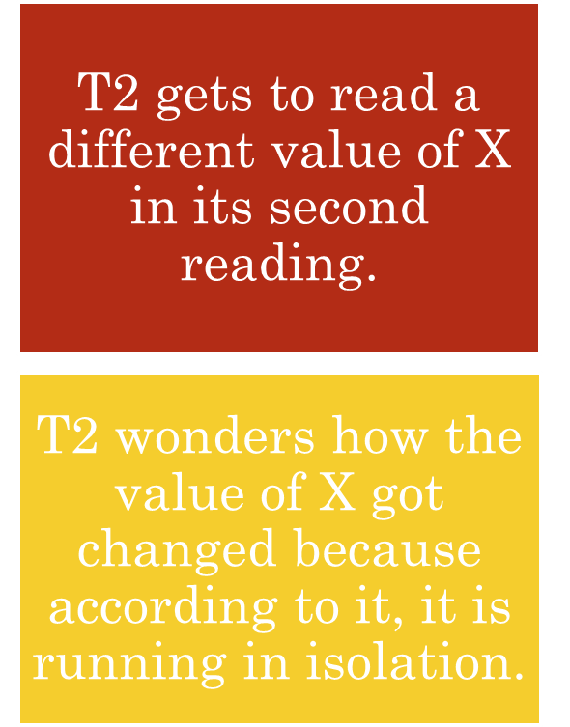
2. UNREPEATABLE READ PROBLEM
Transaction T1 | Transaction T2
R(X)
 | R(X)
W(X)
 | R(X) //Unrepeated Read

Slide 18
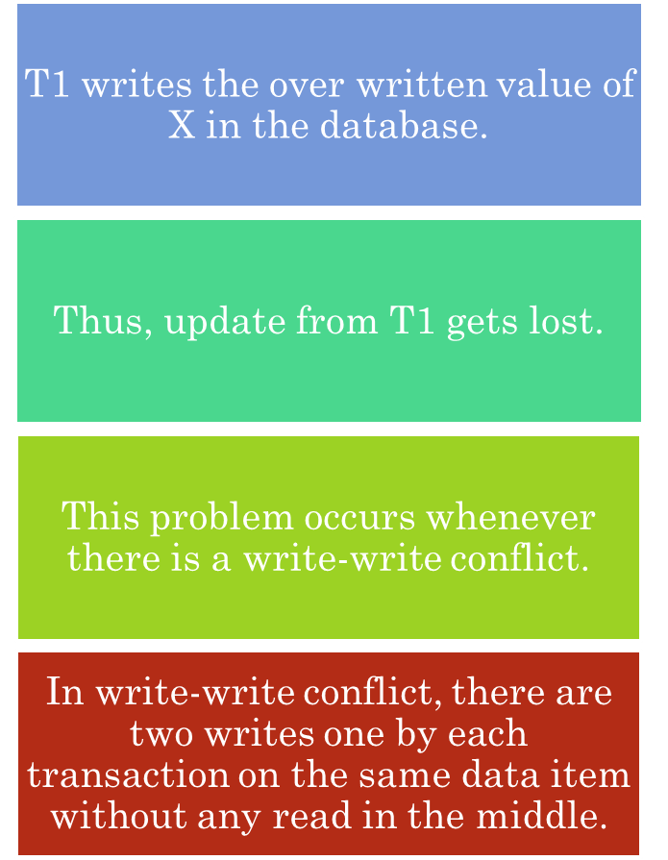
3. LOST UPDATE PROBLEM-
Transaction T1 | Transaction T2
R(A)
W(A)
 | W(A)
 | Commit
Commit

Slide 19
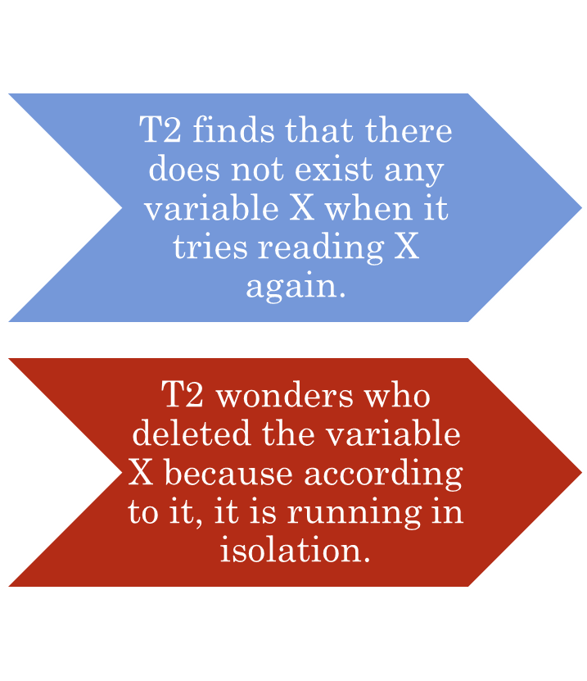
4. PHANTOM READ PROBLEM-
Transaction T1 | Transaction T2
R(X)
 | R(X)
Delete (X)
 | Read (X)

Slide 20
IDENTIFY THE TYPE OF PROBLEM
Transaction T1 | Transaction T2
W(A)
 | R(A)
W (B)
 | R (B)

Slide 21
IDENTIFY THE TYPE OF PROBLEM
Serializable
S=T1-> T2
Dirty Read
But no WR problem
Transaction T1 | Transaction T2
W(A)
 | R(A)
W (B)
 | R (B)

Slide 22
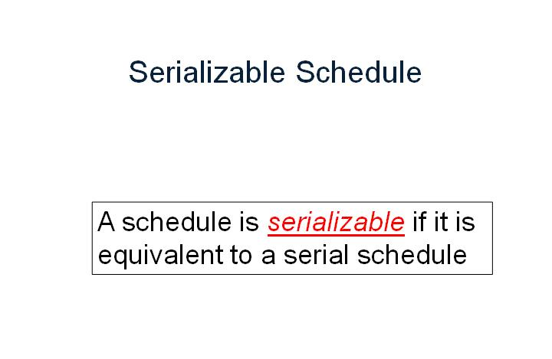

Slide 23
T1 | T2
R(A)
W(A)
R(B)
W(B)
 | R(A)
 | W(A)
 | R(B)
 | W(B)
Serial Schedule
T1 | T2
R(A)
W(A)
 | R(A)
 | W(A)
R(B)
W(B)
 | R(B)
 | W(B)
Serializable Schedule A
T1 | T2
 | R(A)
 | W(A)
R(A)
 | R(B)
 | W(B)
W(A)
R(B)
W(B)
Serializable Schedule B

Slide 24
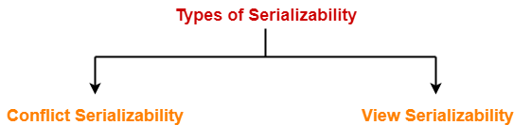
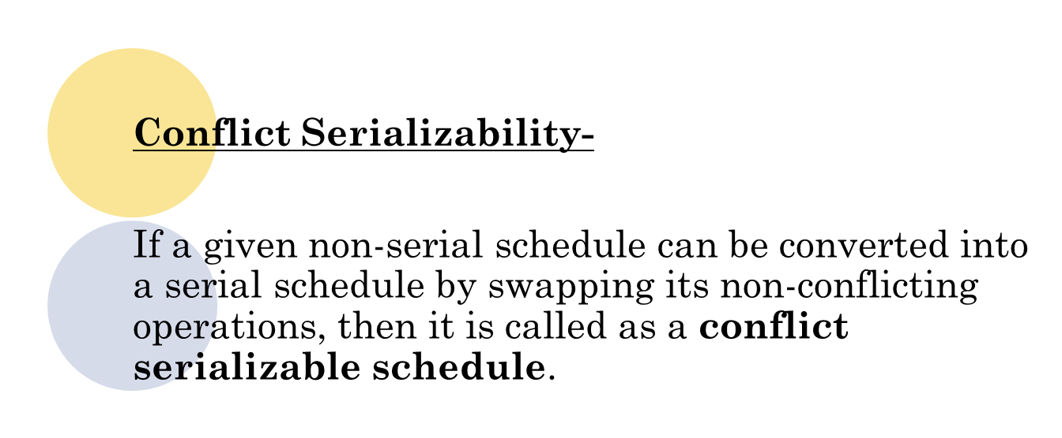

Slide 25
PRACTICE PROBLEMS BASED ON CONFLICT SERIALIZABILITY
Problem-:Check whether the given schedule S is conflict serializable or not-
S : R₁(A) , R₂(A) , R₁(B) , R₂(B) , R₃(B) , W₁(A) , W₂(B)

Slide 26
SOLUTION:
Step1: List all the conflicting operations and determine the dependency between the transactions-
R₂(A) , W₁(A) (T₂ → T₁)
R₁(B) , W₂(B) (T₁ → T₂)
R₃(B) , W₂(B) (T₃ → T₂)

Slide 27
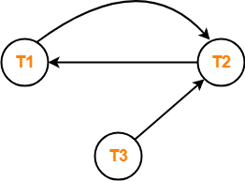
Step 2: Draw the precedence graph
Clearly, there exists a cycle in the precedence graph.
Therefore, the given schedule S is not conflict serializable.

Slide 28
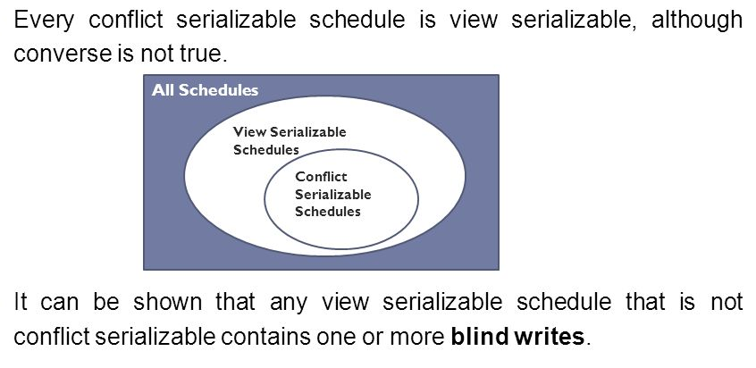
VIEW SERIALIZABILITY-
If a given schedule is found to be view equivalent to some serial schedule, then it is called as a view serializable schedule.

Slide 29
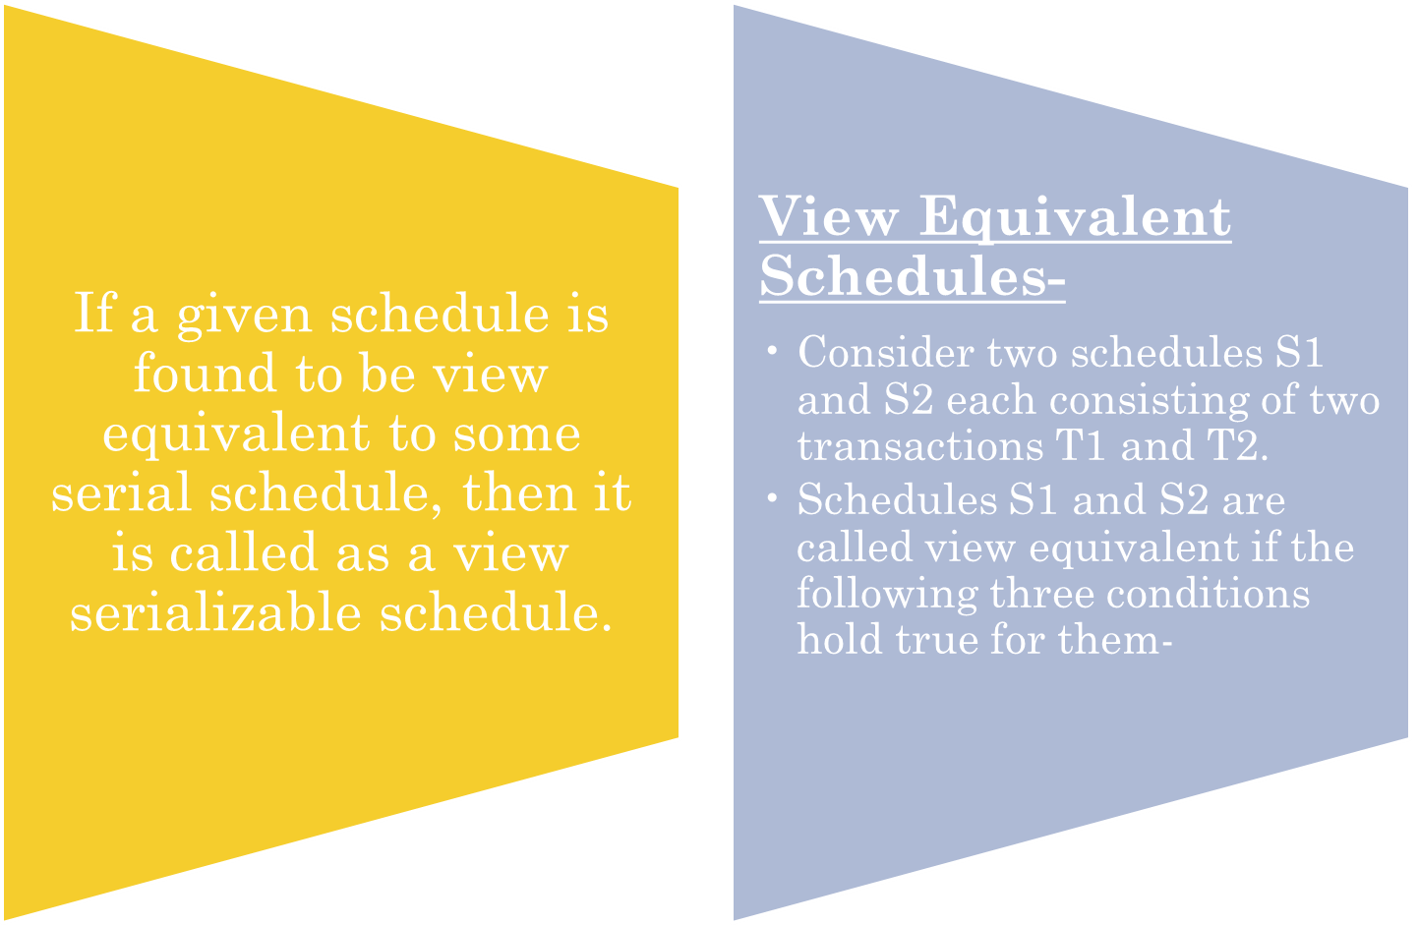
VIEW SERIALIZABILITY-

Slide 30
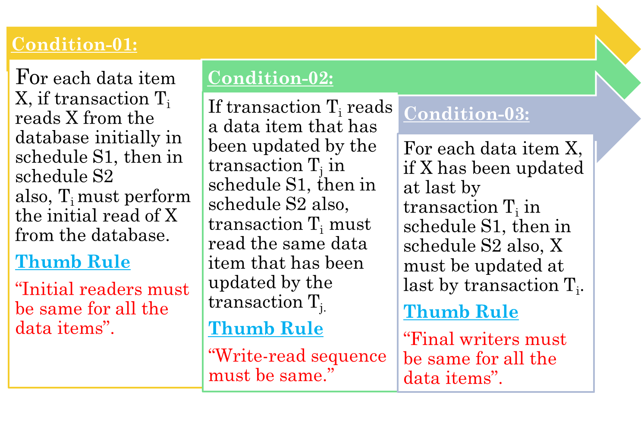
VIEW SERIALIZABILITY-

Slide 31
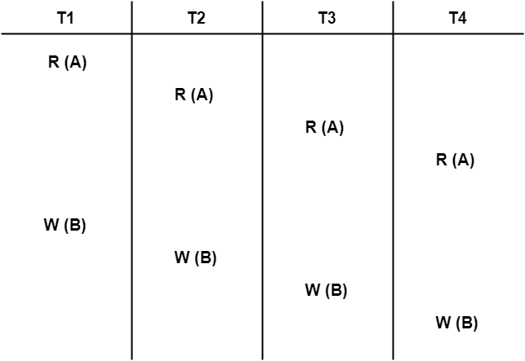
PRACTICE PROBLEMS BASED ON VIEW SERIALIZABILITY-
Check whether the given schedule S is view serializable or not-

Slide 32
PRACTICE PROBLEMS SOLUTION
We know, if a schedule is conflict serializable, then it is surely view serializable.
So, let us check whether the given schedule is conflict serializable or not.
Step-01:
List all the conflicting operations and determine the dependency between the transactions-
  W₁(B) , W₂(B) (T₁ → T₂)
  W₁(B) , W₃(B) (T₁ → T₃)
  W₁(B) , W₄(B) (T₁ → T₄)
  W₂(B) , W₃(B) (T₂ → T₃)
  W₂(B) , W₄(B) (T₂ → T₄)
  W₃(B) , W₄(B) (T₃ → T₄)

Slide 33
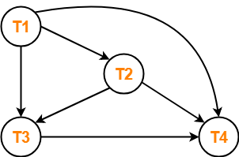
PRACTICE PROBLEMS SOLUTION
Step-02: Draw the precedence graph-
Clearly, there exists no cycle in the precedence graph.
Therefore, the given schedule S is conflict serializable.
Thus, we conclude that the given schedule is also view serializable.

Slide 34
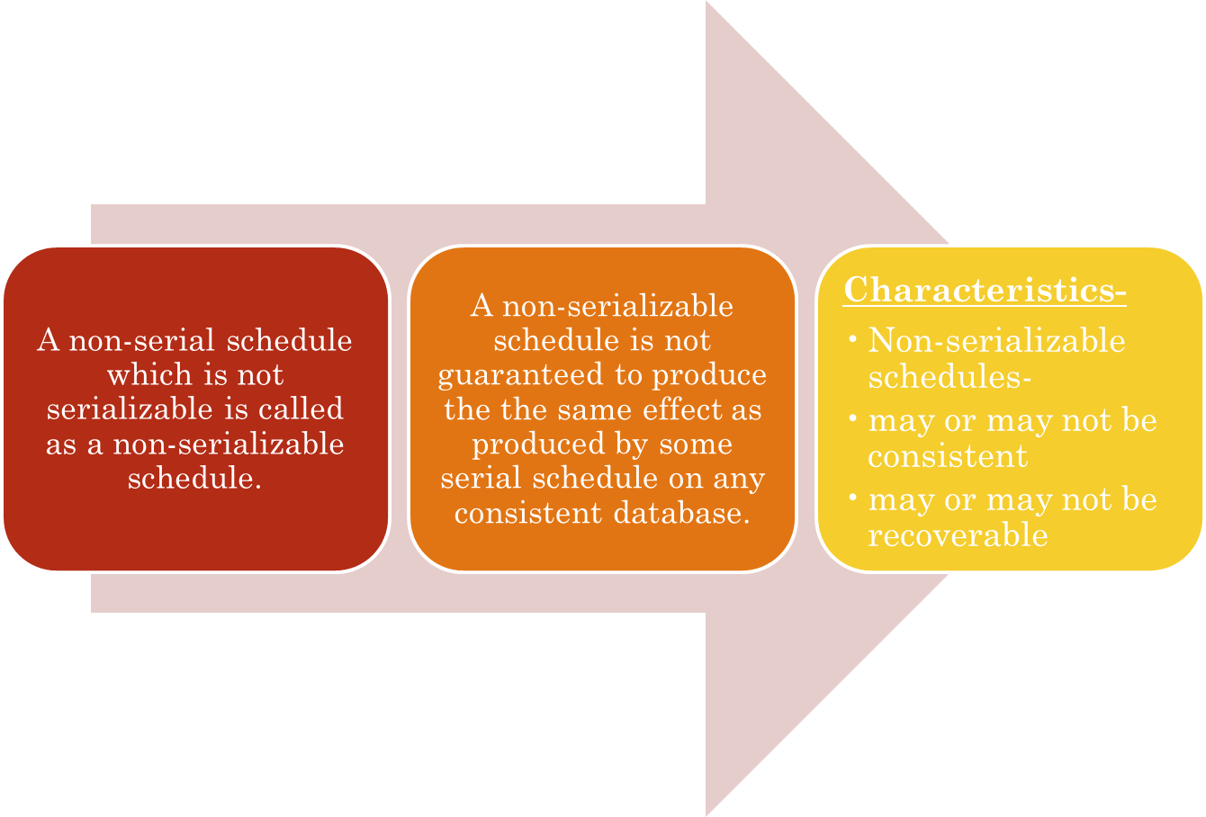
NON-SERIALIZABLE SCHEDULES-

Slide 35
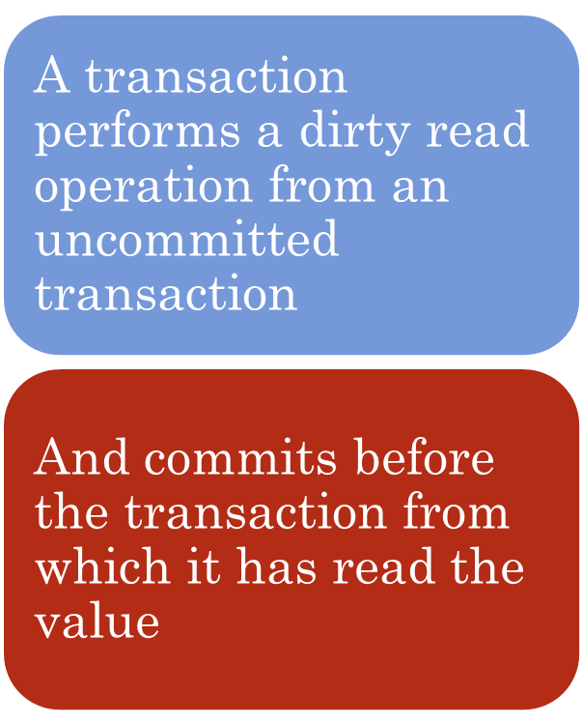
IRRECOVERABLE SCHEDULES-
Transaction T1 | Transaction T2
R(A)
W(A)
 | R(A) //Dirty Read
 | W(A)
 | Commit
Rollback
Irrecoverable Schedule

Slide 36
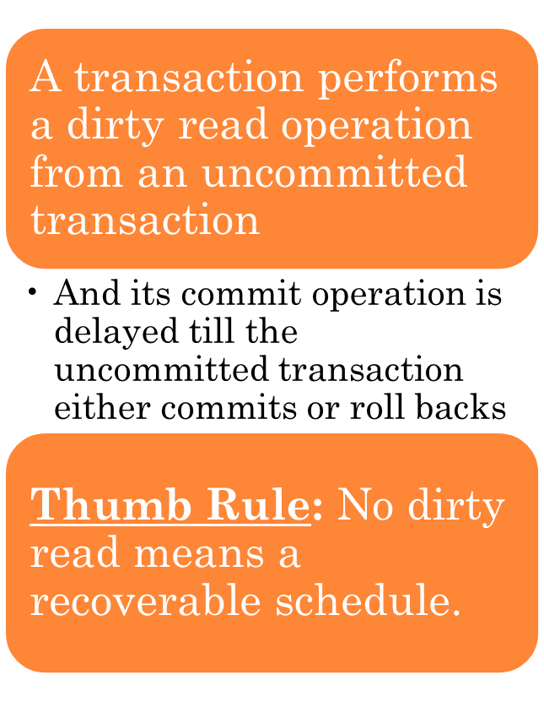
RECOVERABLE SCHEDULES-
Transaction T1 | Transaction T2
R(A)
W(A)
 | R(A) //Dirty Read
 | W(A)
Commit
 | Commit //Delayed
Recoverable Schedule

Slide 37
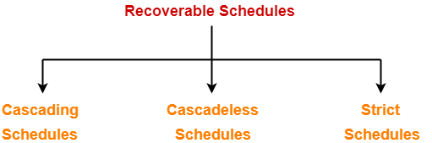
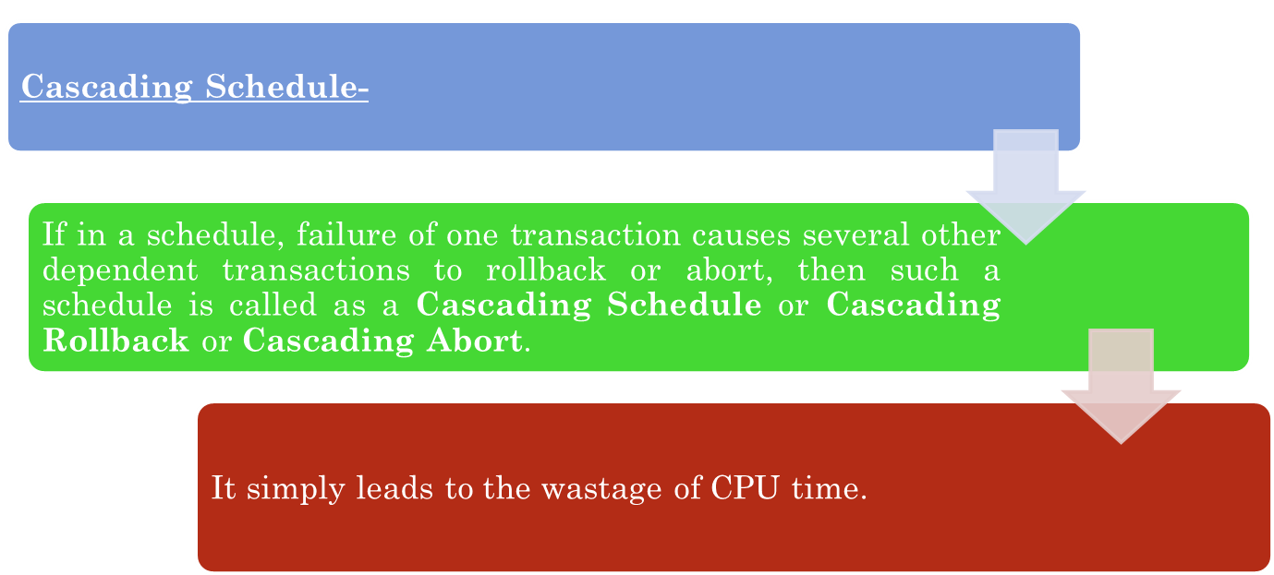

Slide 38
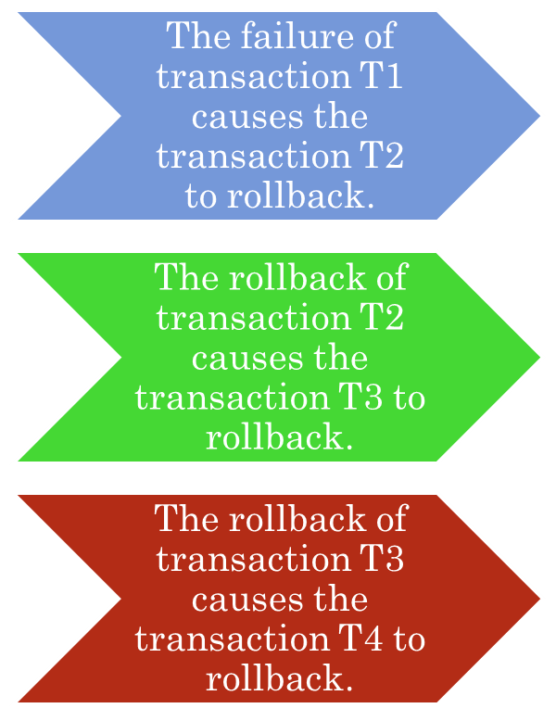
CASCADING ROLLBACK.
T1 | T2 | T3 | T4
R(A)
W(A)
 | R(A)
 | W(A)
 |  | R(A)
 |  | W(A)
 |  |  | R(A)
 |  |  | W(A)
Failure
Cascading Recoverable Schedule

Slide 39
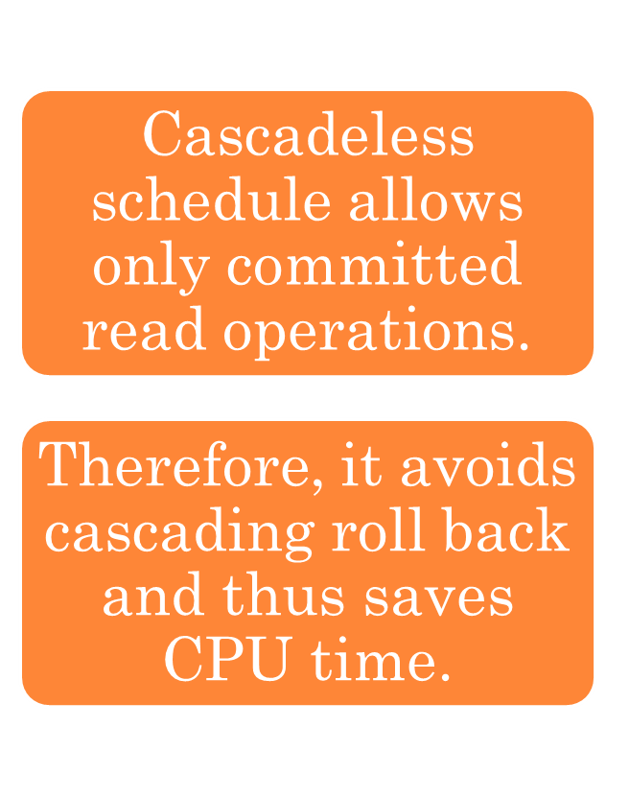
CASCADELESS SCHEDULE-
T1 | T2 | T3 | T4
R(A)
W(A)
Commit
 | R(A)
 | W(A)
 | Commit
 |  | R(A)
 |  | W(A)
 |  |  | Commit
Cascadeless Schedule

Slide 40
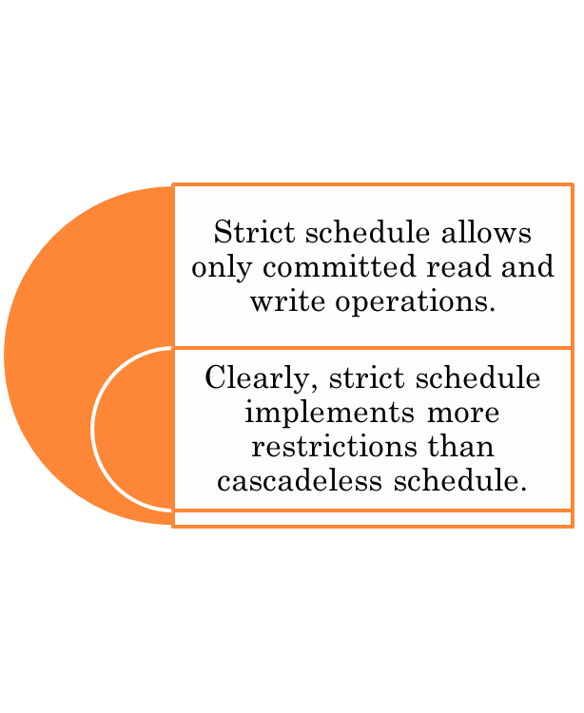
STRICT SCHEDULE-
T1 | T2
W(A)
Commit/Rollback
 | R(A)/W(A)
Strict Schedule

Slide 41
PRACTICE PROBLEMS
PROBLEM-1
T1 | T2
R(A)
 | R(A)
 | W(A)
 | Commit
W(A)
Commit

Slide 42
PRACTICE PROBLEM
SOLUTION
T1 | T2
R(A)
 | R(A)
 | W(A)
 | Commit
W(A)
Commit
Strict Recoverable Schedule Not Serializable RW Problem

Slide 43
PRACTICE PROBLEMS
PROBLEM-2
T1 | T2
R(A)
 | R(A)
 | W(A)
W(A)
Commit
 | Commit

Slide 44
PRACTICE PROBLEM
SOLUTION
T1 | T2
R(A)
 | R(A)
 | W(A)
W(A)
Commit
 | Commit
Recoverable Cascadeless Rollback Not Strict Roverable

Slide 45
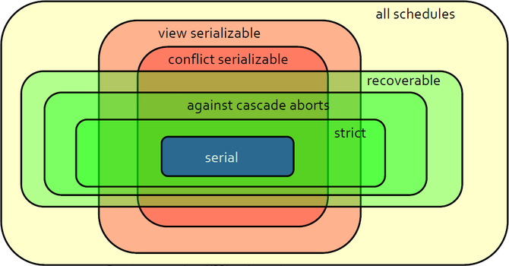
CHARACTERIZING SCHEDULES THROUGH
VENN DIAGRAM

Slide 46
PRACTICE PROBLEM: IDENTIFY THE TYPE OF PROBLEM
Transaction T1 | Transaction T2
R(A)
W(A)
 | W(A)
 | Commit
Commit

Slide 47
PRACTICE PROBLEM SOLUTION:
Transaction T1 | Transaction T2
R(A)
W(A)
 | W(A)
 | Commit
Commit
Lost Update Problem

Slide 48
PRACTICE PROBLEM: IDENTIFY THE TYPE OF PROBLEM
Transaction T1 | Transaction T2
R(X)
 | R(X)
W(X)
 | R(X)

Slide 49
PRACTICE PROBLEM SOLUTION:
Transaction T1 | Transaction T2
R(X)
 | R(X)
W(X)
 | R(X) //Unrepeated Read
Transaction T1 | Transaction T2
R(A)
W(A)
 | R(A)
 | W(A)
 | Commit
Failure

Slide 50
PRACTICE PROBLEM: IDENTIFY THE TYPE OF PROBLEM
Transaction T1 | Transaction T2
R(A)
W(A)
 | R(A)
 | W(A)
 | Commit
Failure

Slide 51
PRACTICE PROBLEM SOLUTION:
Transaction T1 | Transaction T2
R(A)
W(A)
 | R(A) //Dirty Read
 | W(A)
 | Commit
Failure

Slide 52
PRACTICE PROBLEMS
Problem-:Consider the another schedule S1 :
S1: r1(x) r3(y) w1(x) w2(y) r3(x) w2(x)
Is the given schedule is CONFLICT SERIALIZABILITY ?

Slide 53
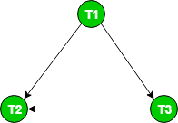
SOLUTION:
The graph for this schedule is :
Since the graph is acyclic, the schedule is conflict serializable.

Slide 54
PRACTICE PROBLEMS
Problem-:Consider the following schedules involving two transactions. Which one of the following statement is true?
S1: R₁(X) R₁(Y) R₂(X) R₂(Y) W₂(Y) W₁(X)
S2: R₁(X) R₂(X) R₂(Y) W₂(Y) R₁(Y) W₁(X)
Both S1 and S2 are conflict serializable
Only S1 is conflict serializable
Only S2 is conflict serializable
None

Slide 55
SOLUTION:
Let us first check serializability of S1:
S1: R1(X) R1(Y) R2(X) R2(Y) W2(Y) W1(X)
To convert it to a serial schedule, we have to swap non-conflicting operations so that S1 becomes equivalent to serial schedule T1->T2 or T2->T1.
In this case, to convert it to a serial schedule, we must have to swap R2(X) and W1(X) but they are conflicting. So S1 can’t be converted to a serial schedule.

Slide 56
Now, let us check serializability of S2:
S2: R1(X) R2(X) R2(Y) W2(Y) R1(Y) W1(X)
Swapping non conflicting operations R1(X) and R2(X) of S2, we get
S2’: R2(X) R1(X) R2(Y) W2(Y) R1(Y) W1(X)
Again, swapping non conflicting operations R1(X) and R2(Y) of S2’, we get
S2’’: R2(X) R2(Y) R1(X) W2(Y) R1(Y) W1(X)
Again, swapping non conflicting operations R1(X) and W2(Y) of S2’’, we get
S2’’’: R2(X) R2(Y) W2(Y) R1(X) R1(Y) W1(X)
which is equivalent to a serial schedule T2->T1.
So, correct option is C. Only S2 is conflict serializable.

Slide 57
PRACTICE PROBLEM:
Consider the following transactions with data items P and Q initialized to zero:
T1: read (P) ;
read (Q) ;
if P = 0 then Q : = Q + 1 ;
write (Q) ;
T2: read (Q) ;
read (P) ;
if Q = 0 then P : = P + 1 ;
write (P) ;
Any non-serial interleaving of T1 and T2 for concurrent execution leads to
(A) A serializable schedule
(B) A schedule that is not conflict serializable
(C) A conflict serializable schedule
(D) A schedule for which a precedence graph cannot be drawn

Slide 58
PRACTICE PROBLEM SOLUTION:
Answer (B)
Two or more actions are said to be in conflict if:
1) The actions belong to different transactions.
2) At least one of the actions is a write operation.
3) The actions access the same object (read or write).
The schedules S1 and S2 are said to be conflict-equivalent if the following conditions are satisfied:
1) Both schedules S1 and S2 involve the same set of transactions (including ordering of actions within each transaction).
2) The order of each pair of conflicting actions in S1 and S2 are the same.

Slide 59
PRACTICE PROBLEMS BASED ON VIEW SERIALIZABILITY-
Check whether the given schedule S is view serializable or not-

Slide 60
PRACTICE PROBLEMS SOLUTION
We know, if a schedule is conflict serializable, then it is surely view serializable.
So, let us check whether the given schedule is conflict serializable or not.
Step-01:
List all the conflicting operations and determine the dependency between the transactions-
  W₁(B) , W₂(B) (T₁ → T₂)
  W₁(B) , W₃(B) (T₁ → T₃)
  W₁(B) , W₄(B) (T₁ → T₄)
  W₂(B) , W₃(B) (T₂ → T₃)
  W₂(B) , W₄(B) (T₂ → T₄)
  W₃(B) , W₄(B) (T₃ → T₄)

Slide 61
PRACTICE PROBLEMS SOLUTION
Step-02: Draw the precedence graph-
Clearly, there exists no cycle in the precedence graph.
Therefore, the given schedule S is conflict serializable.
Thus, we conclude that the given schedule is also view serializable.

Slide 62
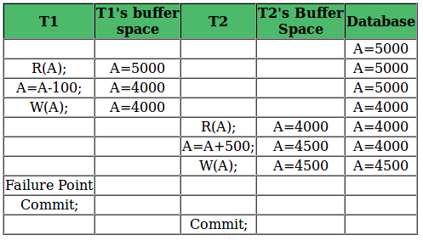
IS THE GIVEN SCHEDULE IS RECOVERABLE SCHEDULE OR RECOVERABLE SCHEDULE?

Slide 63
SOLUTION
Above table shows a schedule with two transactions, T1 reads and writes A and that value is read and written by T2. T2 commits.
But later on, T1 fails. So we have to rollback T1. Since T2 has read the value written by T1, it should also be rollbacked.
But we have already committed that.
So this schedule is irrecoverable schedule.

Slide 64
IS THE GIVEN SCHEDULE IS RECOVERABLE SCHEDULE OR RECOVERABLE SCHEDULE?

Slide 65
SOLUTION
Table shows a schedule with two transactions, T1 reads and writes A and that value is read and written by T2.
But later on, T1 fails. So we have to rollback T1. Since T2 has read the value written by T1, it should also be rollbacked.
As it has not committed, we can rollback T2 as well. So it is recoverable with cascading rollback.
Recoverable with cascading rollback: If Tj is reading value updated by Ti and commit of Tj is delayed till commit of Ti , the schedule is called recoverable with cascading rollback.

Slide 66
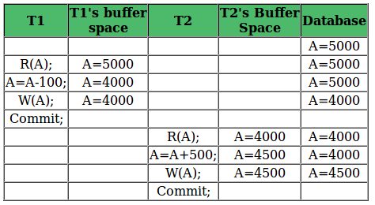
IS THE GIVEN SCHEDULE IS RECOVERABLE SCHEDULE OR RECOVERABLE SCHEDULE?

Slide 67
SOLUTION
Table 3 shows a schedule with two transactions, T1 reads and writes A and commits and that value is read by T2.
But if T1 fails before commit, no other transaction has read its value, so there is no need to rollback other transaction.
So this is a cascadeless recoverable schedule.

Slide 68
PRACTICE PROBLEMS
PROBLEM-1
T1 | T2
R(A)
 | R(A)
 | W(A)
 | Commit
W(A)
Commit

Slide 69
PRACTICE PROBLEM
SOLUTION
T1 | T2
R(A)
 | R(A)
 | W(A)
 | Commit
W(A)
Commit
Strict Recoverable Schedule Not Serializable RW Problem

Slide 70
PRACTICE PROBLEMS
PROBLEM-2
T1 | T2
R(A)
 | R(A)
 | W(A)
W(A)
Commit
 | Commit

Slide 71
PRACTICE PROBLEM
SOLUTION
T1 | T2
R(A)
 | R(A)
 | W(A)
W(A)
Commit
 | Commit
Recoverable Cascadeless Rollback Not Strict Roverable

Slide 72
THANKS!!

